Slide 1
Seq2seq model and application for machine translation
Tran Hong Viet
UET, VNU-Hanoi

Slide 2
Content
Introduction to Machine Translation
The seq2seq model
Attention mechanism
Practice: Machine translation với mô hình seq2seq

Slide 3
Machine Translation (Dịch máy)
Machine Translation (MT) is the task of translating a sentence x from one language (the source language) to a sentence y in another language (the target language).
x: L'homme est né libre, et partout il est dans les fers
y: Man is born free, but everywhere he is in chains
Notes:
Rousseau
European bias in this lecture

Slide 4
What is Neural Machine Translation?
Neural Machine Translation (NMT) is a way to do Machine Translation with a single neural network
The neural network architecture is called sequence-to-sequence (aka seq2seq) and it involves two RNNs (LSTMs).

Slide 5
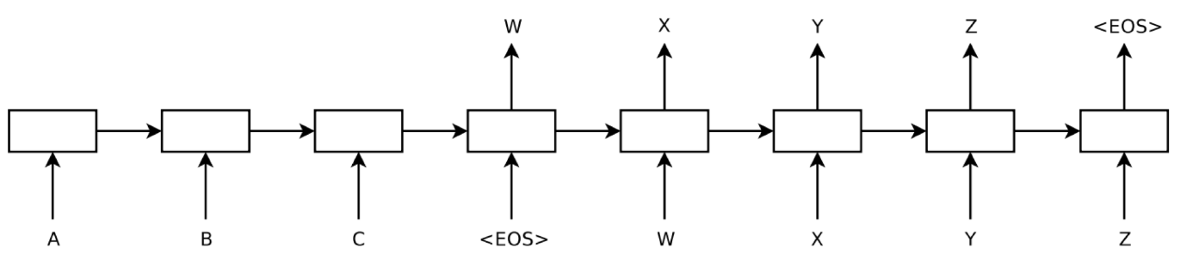
Encoder-decoder Framework
Decoder (RNN/LSTM)
Encoder (RNN/LSTM)
“Sequence to Sequence Learning with Neural Networks”, 2014

Slide 6
Encoder-decoder Framework
_{Vector K-dimention of context}
Condition of the word to be generate from the translation system
“Sequence to Sequence Learning with Neural Networks”, 2014

Slide 7
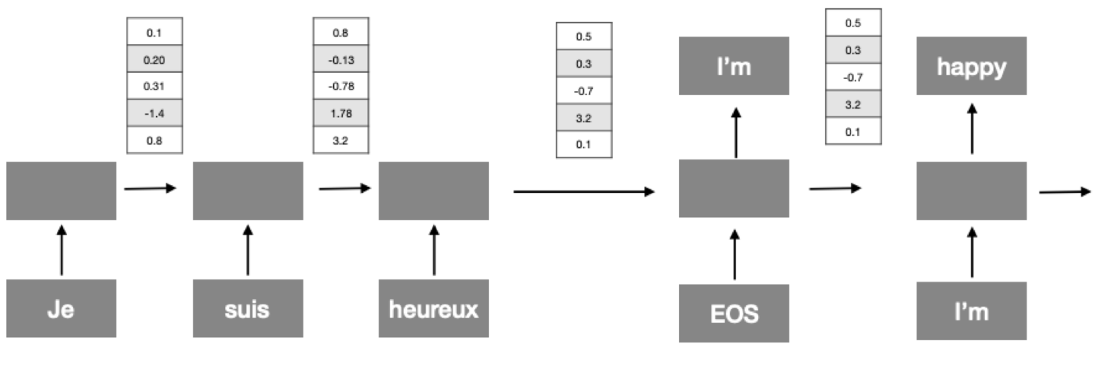
Encoder-decoder Framework

Slide 8
Encoder-decoder Framework
All inputs are aggregatedin this single vector
In the seq2seq, the decoder's state depends only on the previous state and the previous output

Slide 9
Neural Machine Translation
The sequence-to-sequence model
Target sentence (output)
Encoding of the source sentence. Provides initial hidden state for Decoder RNN.
the
poor
don’t
have any money <END>
argmax
argmax
argmax
argmax
argmax
argmax
argmax
Encoder RNN
Decoder RNN
les pauvres sont démunis
<START>
the
poor
don’t have any money
Source sentence (input)
Decoder RNN is a Language Model that generates target sentence conditioned on encoding.
Encoder RNN produces an encoding of the source sentence.
Note: This diagram shows test time behavior: decoder output is fed in as next step’s input
Notes:
Note there’s an embedding layer but it’s not in this picture
You have two separate sets of word embeddings, for the two languages
Note: these can be deep/bidir/lstm

Slide 10
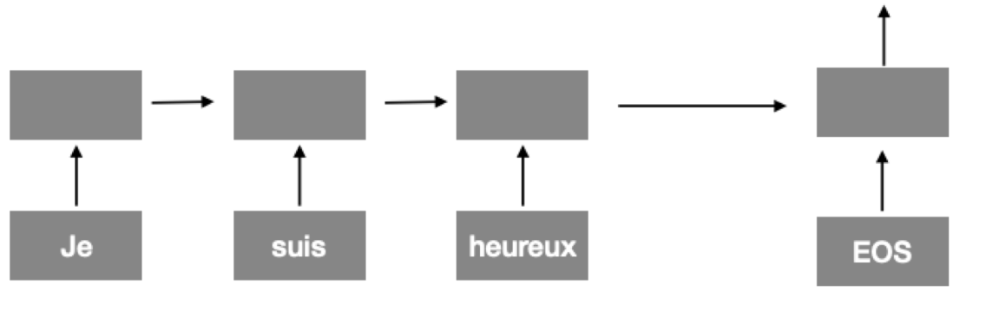
Training of NMT system
As in other RNN models, we can train by minimizing the loss function between what we predict at each step and its ground true value.

Slide 11
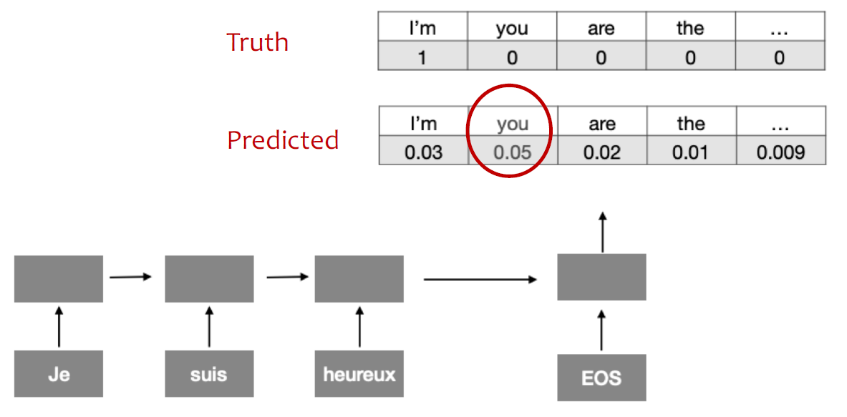
Training of NMT system

Slide 12
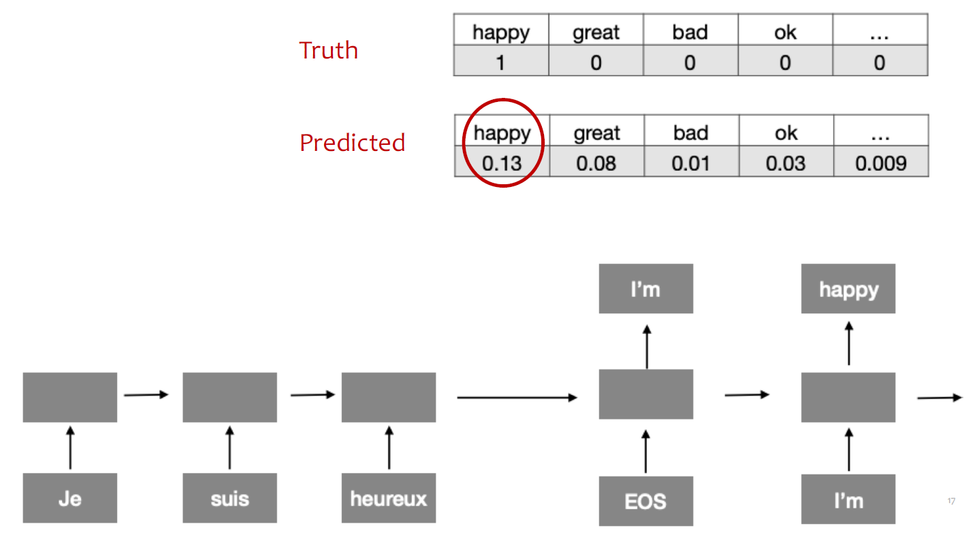

Slide 13
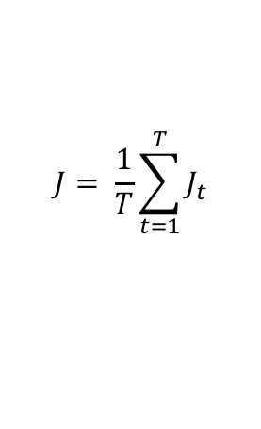














Training of NMT system
= negative log prob of “the”
= negative log prob of “have”
= negative log prob of <END>
= + + + + + +
Encoder RNN
Decoder RNN
les pauvres sont démunis
<START> the poor don’t have any money
Source sentence (from corpus)
Target sentence (from corpus)
Seq2seq is optimized as a single system.
Backpropagation operates “end to end”.
Notes:
This is all exactly like how you train a LM, except you also do the encoder part.

Slide 14
Better-than-greedy decoding?
Greedy decoding has no way to undo decisions!
les pauvres sont démunis (the poor don’t have any money)
→ the ____
→ the poor ____
→ the poor are ____
Better option: use beam search (a search algorithm) to explore several hypotheses and select the best one

Slide 15
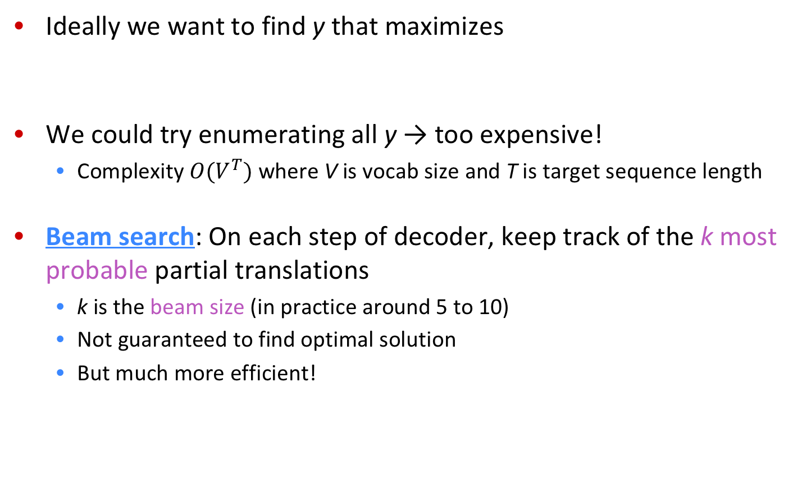
Decoder based on Beam search

Slide 16
Decoder based on Beam search: Example
Beam size = 2
<START>

Slide 17
Decoder based on Beam search: Example
Beam size = 2
the
<START>
a

Slide 18
Decoder based on Beam search: Example
Beam size = 2
poor
the
people
<START>
poor
a
person

Slide 19
Decoder based on Beam search: Example
Beam size = 2
are
poor
the
don’t
people
<START>
person
poor
a
but
person

Slide 20
Decoder based on Beam search: Example
Beam size = 2
always
not
are
poor
the
don’t
have
people
take
<START>
person
poor
a
but
person

Slide 21
Decoder based on Beam search: Example
Beam size = 2
always
in
not
are
with
poor
the
don’t
have
people
take
any
<START>
enough
person
poor
a
but
person

Slide 22
Decoder based on Beam search: Example
Beam size = 2
always
in
not
are
with
poor
money
the
don’t
have
people
funds
take
any
<START>
enough
person
money
poor
a
but
funds
person

Slide 23
Decoder based on Beam search: Example
Beam size = 2
always
in
not
are
with
poor
money
the
don’t
have
people
funds
take
any
<START>
enough
person
money
poor
a
but
funds
person

Slide 24
Beam search: stopping criterion
In greedy decoding, usually we decode until the model produces an <END>
Ví dụ : <START> he hit me with a pie <END>
In beam search decoding, different hypotheses may produce <END> tokens on different timesteps
When a hypothesis produces <END>, that hypothesis is complete.
Place it aside and continue exploring other hypotheses via beam search.
Usually we continue beam search until:
We reach timestep T (where T is some pre-defined cutoff), or
We have at least n completed hypotheses (where n is pre-defined cutoff)

Slide 25
Advantage of NMT
Compared to SMT, NMT has many advantages: Better performance
More fluent
Better use of context
Better use of phrase similarities
A single neural network to be optimized end-to-end
No subcomponents to be individually optimized
Requires much less human engineering effort
No feature engineering
Same method for all language pairs
Notes:
Note google mt team size

Slide 26
Weakness of NMT?
Compared to SMT:
NMT is less interpretable
Hard to debug
NMT is difficult to control
For example, can’t easily specify rules or guidelines for translation
Safety concerns!
Notes:
Note google mt team size

Slide 27
How to evaluation MT system?
BLEU (Bilingual Evaluation Understudy)
BLEU compares the machine-written translation to one or several human-written translation(s), and computes a similarity score based on:
n-gram precision (usually up to 3 or 4-grams)
Penalty for too-short system translations
BLEU is useful but imperfect
There are many valid ways to translate a sentence
So a good translation can get a poor BLEU score because it has low n-gram overlap with the human translation ☹
Notes:
More useful at the lower end of perf
We need better metrics; this is its own area of research

Slide 28
Sequence-to-sequence: the bottleneck problem
Encoding of the source sentence.
Target sentence (output)
the poor don’t have any money <END>
Encoder RNN
Decoder RNN
les pauvres sont démunis
<START> the poor don’t have any money
Source sentence (input)
Problems with this architecture?
Notes:
Can anyone see any problems with this?

Slide 29
Sequence-to-sequence: the bottleneck problem
Encoding of the source sentence. This needs to capture all information about the source sentence.
Information bottleneck!
Target sentence (output)
the poor don’t have any money <END>
Encoder RNN
Decoder RNN
les pauvres sont démunis
<START> the poor don’t have any money
Source sentence (input)
Notes:
Can anyone see any problems with this?

Slide 30
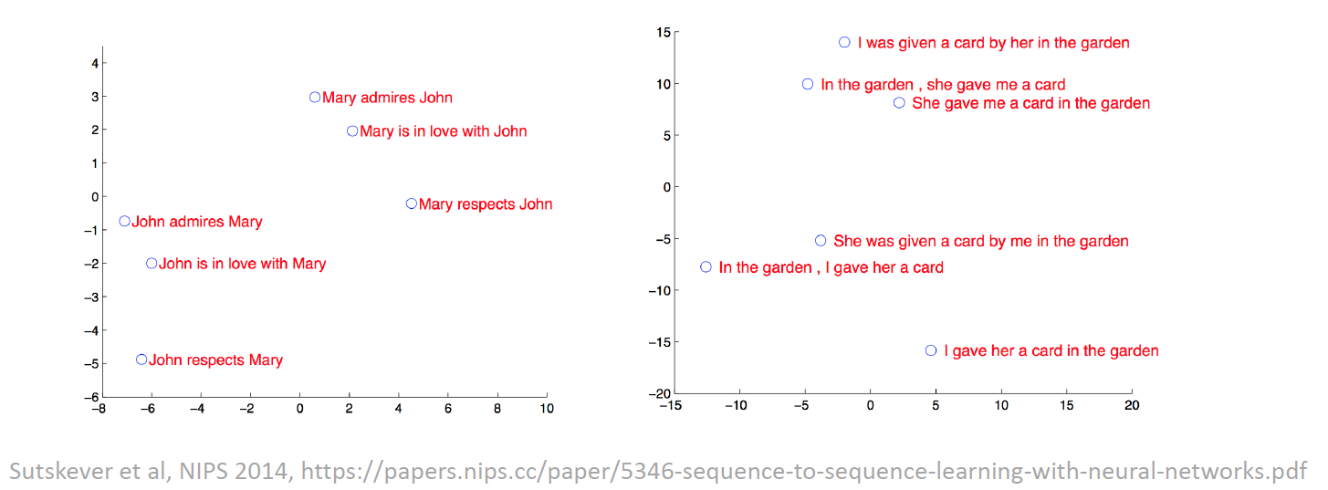
Watching sentence embedding

Slide 31

Attention (Chú ý)
Attention: Solution for bottleneck problem.
Main idea: on each step of the decoder, use direct connection to the encoder to focus on a particular part of the source sequence

Slide 32
Encoder-Decoder với Attention
dot product
Attention scores
Encoder RNN
Decoder RNN
les pauvres sont démunis
<START>
Source sentence (input)
Notes:
Can anyone see any problems with this?

Slide 33
Seq2Seq with attention
dot product
Attention scores
Encoder RNN
Decoder RNN
les pauvres sont démunis
<START>
Source sentence (input)
Notes:
Can anyone see any problems with this?

Slide 34
Sequence-to-sequence with attention
dot product
Attention scores
Encoder RNN
Decoder RNN
les pauvres sont démunis
<START>
Source sentence (input)
Notes:
Can anyone see any problems with this?

Slide 35
Sequence-to-sequence with attention
dot product
Attention scores
Encoder RNN
Decoder RNN
les pauvres sont démunis
<START>
Source sentence (input)
Notes:
Can anyone see any problems with this?

Slide 36
Sequence-to-sequence with attention
On this decoder timestep, we’re mostly focusing on the first encoder hidden state (”les”)
Attention distribution
Take softmax to turn the scores into a probability distribution
Attention scores
Encoder RNN
Decoder RNN
les pauvres sont démunis
<START>
Source sentence (input)
Notes:
Can anyone see any problems with this?

Slide 37
Sequence-to-sequence with attention
Attention output
Use the attention distribution to take a weighted sum of the encoder hidden states.
The attention output mostly contains information the hidden states that received high attention.
Attention distribution
Attention scores
Encoder RNN
Decoder RNN
les pauvres sont démunis
<START>
Source sentence (input)
Notes:
Can anyone see any problems with this?

Slide 38
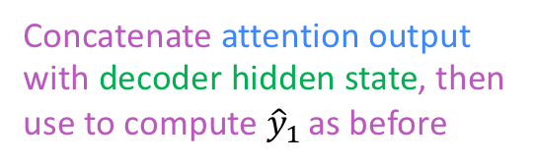

Sequence-to-sequence with attention
Attention output
the
Attention distribution
Attention scores
Encoder RNN
Decoder RNN
les pauvres sont démunis
<START>
Source sentence (input)
Notes:
Can anyone see any problems with this?

Slide 39

Sequence-to-sequence with attention
Attention output
poor
Attention distribution
Attention scores
Encoder RNN
Decoder RNN
les pauvres sont démunis
<START>
the
Source sentence (input)
Notes:
Can anyone see any problems with this?

Slide 40

Sequence-to-sequence with attention
Attention output
don’t
Attention distribution
Attention scores
Encoder RNN
Decoder RNN
les pauvres sont démunis
<START>
the
poor
Source sentence (input)
Notes:
Can anyone see any problems with this?

Slide 41

Sequence-to-sequence with attention
Attention output
have
Attention distribution
Attention scores
Encoder RNN
Decoder RNN
les pauvres sont démunis
<START>
the
poor
don’t
Source sentence (input)
Notes:
Can anyone see any problems with this?

Slide 42

Sequence-to-sequence with attention
Attention output
any
Attention distribution
Attention scores
Encoder RNN
Decoder RNN
les pauvres sont démunis
<START>
the
poor
don’t
have
Source sentence (input)
Notes:
Can anyone see any problems with this?

Slide 43

Sequence-to-sequence with attention
Attention output
money
Attention distribution
Attention scores
Encoder RNN
Decoder RNN
les pauvres sont démunis
<START>
the
poor
don’t
have
any
Source sentence (input)
Notes:
Can anyone see any problems with this?

Slide 44
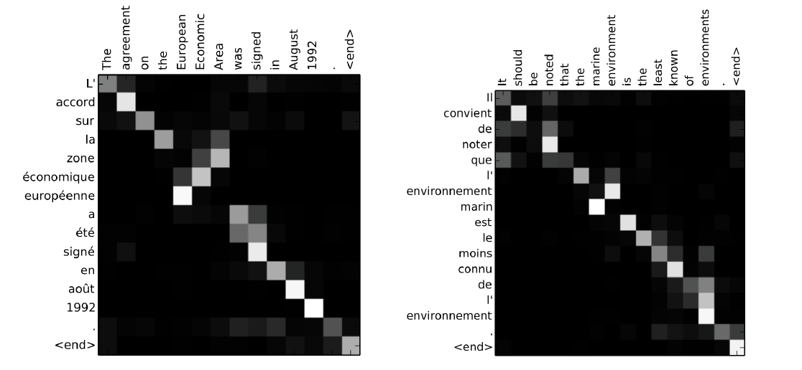
Neural Machine Translation by Jointly Learn to Align and Translate
Source: Bahdanau et al., ICLR 2015, https://arxiv.org/abs/1409.0473

Slide 45
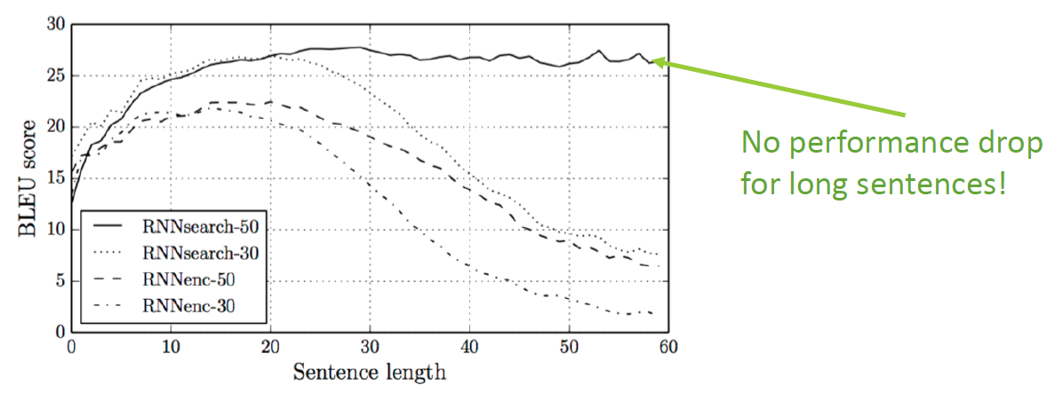
Neural Machine Translation by Jointly Learn to Align and Translate
Source: Bahdanau et al., ICLR 2015, https://arxiv.org/abs/1409.0473

Slide 46
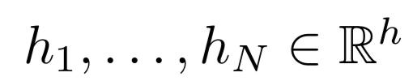

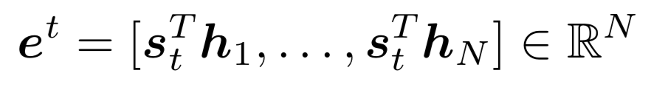
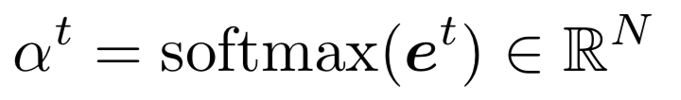
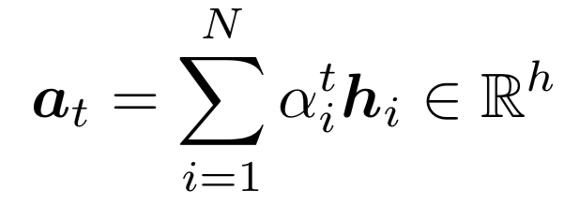
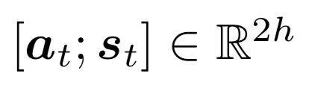
Attention: Formula
We have encoder hidden states (values)
On timestep t, we have (query s) decoder hidden state
We get the attention scores for this step:
We take softmax to get the attention distribution for this step (this is a probability distribution and sums to 1)
We use to take a weighted sum of the encoder hidden states to get the attention output
Finally we concatenate the attention output with the decoder hidden state and proceed as in the non-attention seq2seq model
There are
multiple ways
to do this

Slide 47



Attention scoring function
q is the query and k is the key
Multi-layer Perceptron (Bahdanau et al. 2015)
Flexible, often very good with large data
Bilinear (Luong et al. 2015)
Dot Product (Luong et al. 2015)

Slide 48
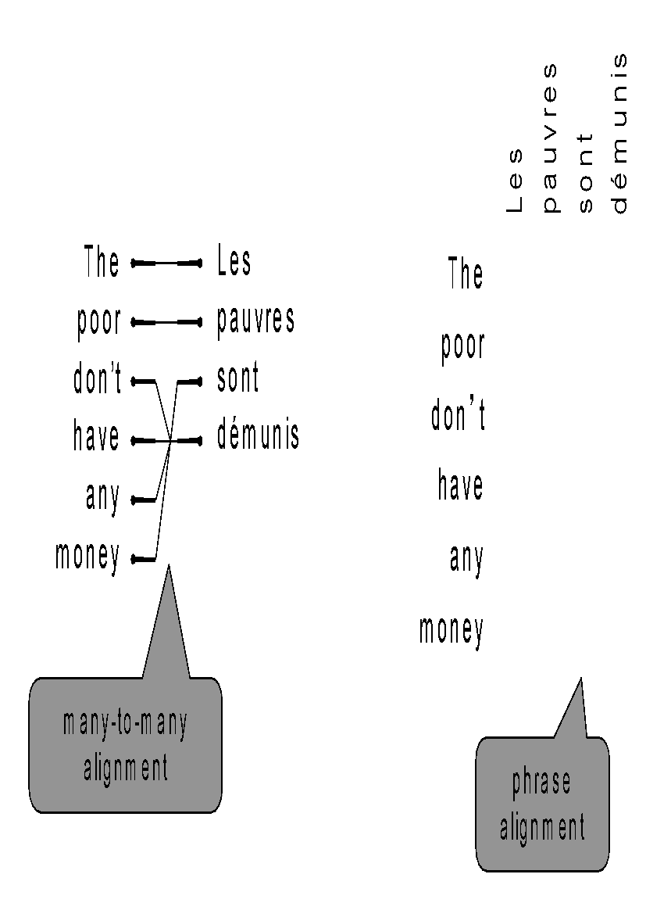
Attention is so great (Bahdanau at al., 16054 Citations)
Attention significantly improves NMT performance
It’s very useful to allow decoder to focus on certain parts of the source
Attention provides a more “human-like” model of the MT process
You can look back at the source sentence while translating, rather than needing to remember it all
Attention solves the bottleneck problem
Attention allows decoder to look directly at source; bypass bottleneck
Attention helps with the vanishing gradient problem
Attention provides some interpretability
By inspecting attention distribution, we can see what the decoder was focusing on
We get alignment for free!
This is cool because we never explicitly trained an alignment system
The network just learned alignment by itself

Slide 49
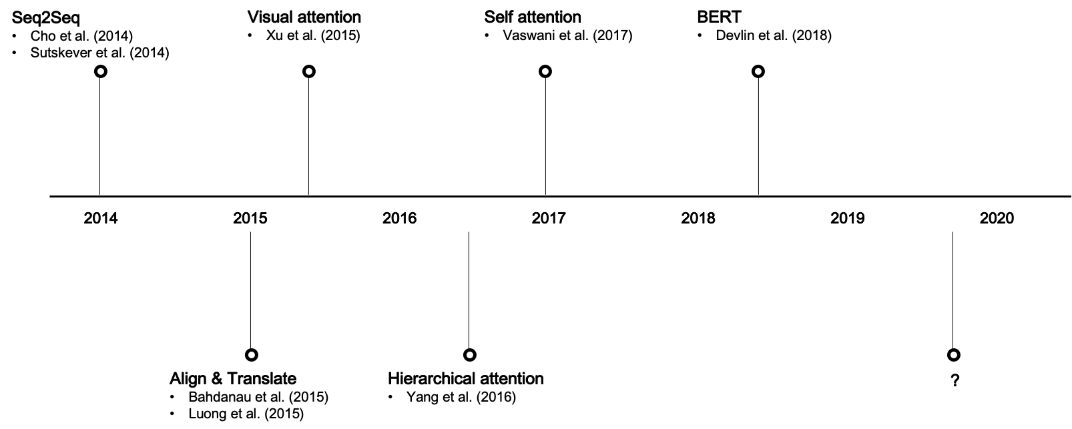
Key developments in attention
ChatGpt
GPT3

Slide 50
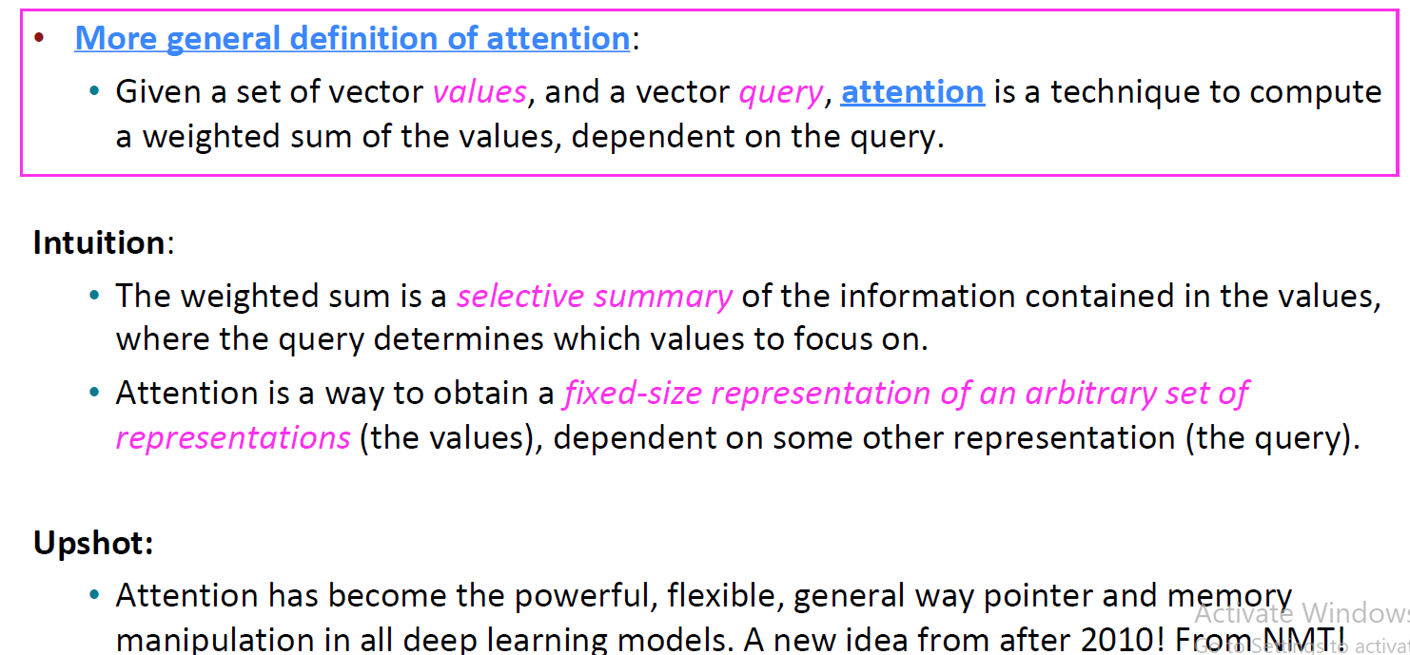
Attention is a general Deep Learning technique

Slide 51
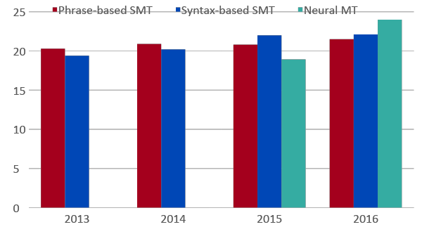
Evolution of the MT system over time
[Edinburgh En-De WMT newstest2013 Cased BLEU; NMT 2015 from U. Montréal]
Source: http://www.meta-net.eu/events/meta-forum-2016/slides/09_sennrich.pdf

Slide 52

NMT: the first big story of NLP Deep Learning
Neural Machine Translation went from a fringe research activity in 2014 to the leading standard method in 2016
2014: First seq2seq paper published [Sutskever et al., 2014]
2016: Google Translate switches from SMT to NMT and by 2018 everyone has
This is amazing!
SMT systems, built by hundreds of engineers over many years, outperformed by NMT systems trained by a small groups of engineers in a few months
Notes:
Note google mt team size, decades of work beaten by simple new system
you can make it deep, make the encoder bidirectional, obviously upgrade the RNN cell, feed in the source backwards, speed up the softmax computation, pretrain on other stuff, one network for all languages, many many tips and tricks link brain hyperparameter paper

Slide 53
MT solved?
Nope!
Many difficulties remain:
Out-of-vocabulary words (unknow words)
Domain mismatch between train and test data
Maintaining context over longer text
Low-resource language pairs (Hallucinations)

Slide 54



MT solved?
Nope!
Using common sense is still hard
?

Slide 55
Seq2seq is flexible and efficient!
Seq2Seq is useful not only in the Machine Translation
Many NLP tasks can be phrased as sequence-to-sequence:
Summarization (long text → short text)
Dialogue (previous utterances → next utterance)
Parsing (input text → output parse as sequence)
Code generation (natural language → Python code)
OCR (image of character → text sequcence)
ASR (sequence of Acoustic → text sequence)

Slide 56
Machine Translation Problem
Automatic translation from English sentence to Vietnamese sentence
Training và testing data: IWSLT 2015
Example:
Input: I like a blue book
Oputput: Tôi thích quyển sách màu xanh

Slide 57
Apply seq2seq + attention for NMT
Goals to be achieved:
Training seq2seq model for English-Vietnamese translation problem.
Evaluating the translation system by BLEU score.
Seing Attention score matrix to better understand the model
The tasks to be implemented:
Data preprocessing
Create training data
Write encoder, decoder, attention modul
Training model
Translate new source sentence
Show Attention, BLEU score.

Slide 58
Conclusion
Sequence-to-sequence is the architecture of most current NLP problems such as NMT, text generation, ...
Attention great is a way to focus on particular parts of the input
Improved Seq2Seq model a lot!
As the foundation of the Transformer model (now dominated!)

Slide 59
References
Speech and Language Processing 2023 (https://web.stanford.edu/~jurafsky/slp3/)
Machine Translation and Sequence-to-Sequence Models, Neubig, 2019, CMU
Some slides for Universities of Stanford 2023, MIT, …

